Slide 1
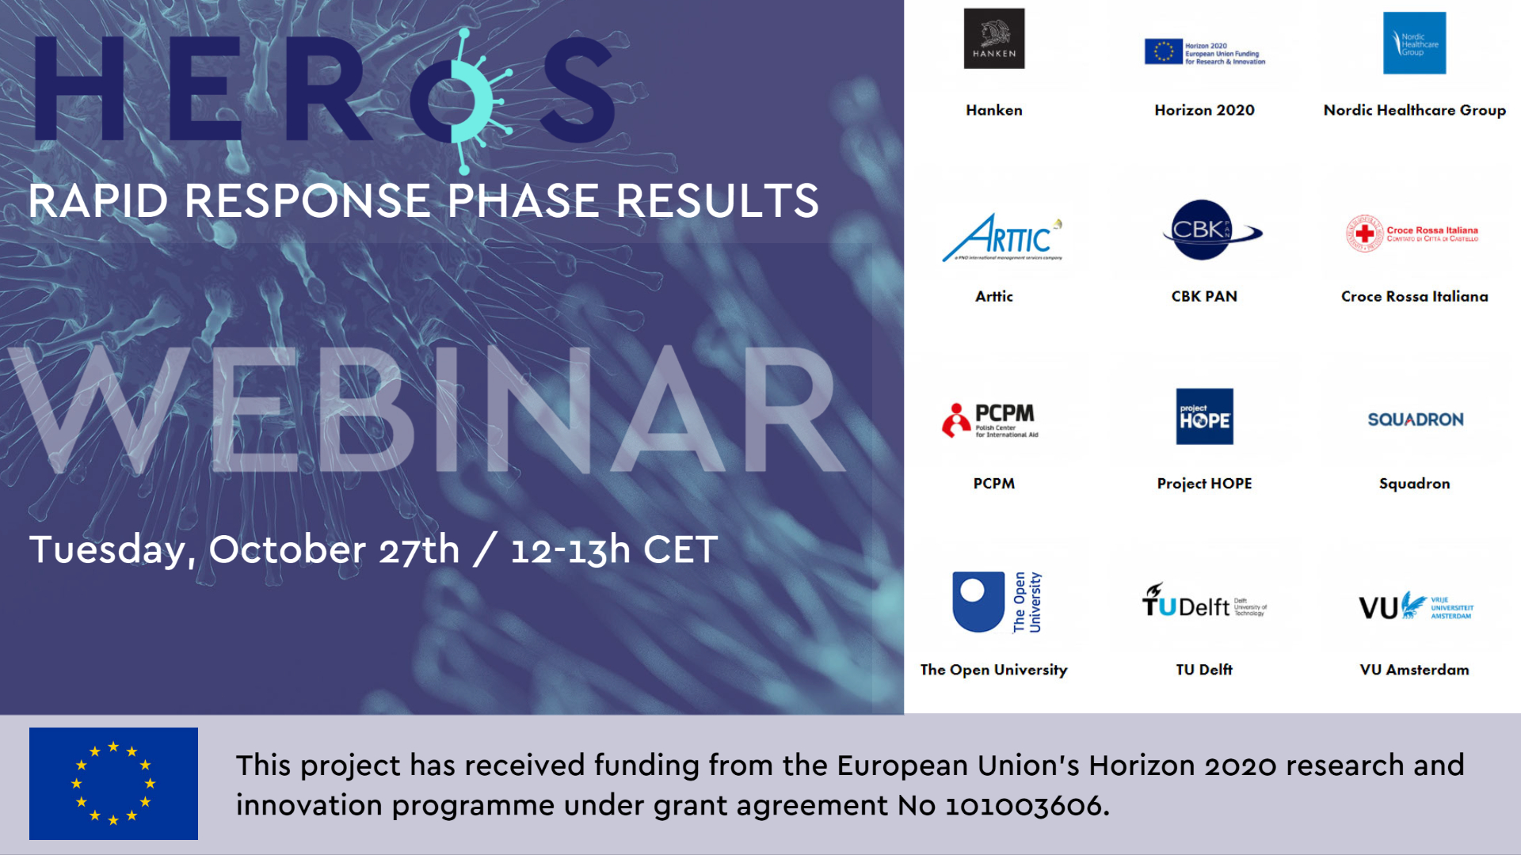
HERoS – webinar on the results from the rapid response phase
27 October 2020

Slide 2
HERoS Rapid Response Phase
HERoS Rapid Response Phase
  HERoS first six months were designed as a rapid response phase, with exploratory analyses for fast recommendations on the basis of
  Analysis of governance arrangements in the ongoing Covid-19 response
  Local behavioural model and recommendations for local COVID-19 response
  Public health system analysis and recommendations
  Gap analysis and recommendations for securing medical supplies
  Covid-19 misinformation spread analysis
  With case studies from Italy, the Netherlands, Finland, and more.
HERoS consortium

Slide 3
D1.1 Recommendations for governance and policies in the COVID-19 response
Health Emergency Response in Interconnected Systems (HERoS)
Kees Boersma (Vrije Universiteit Amsterdam)

Slide 4
HERoS/D1.1 Objectives and methods
  Objective: to provide a Governance Framework to analyse workflows, processes, coordination structures and governance arrangements in the response to Covid-19 and to learn from it.
  Overall questions: How did various formal and informal stakeholders govern the COVID-19 crisis situation over time? How did they collectively make sense of the evolving situation and make joint decisions? How did the involved agencies collaborate and coordinate their activities?
Methods: the Governance Framework relies on a grounded theory informed methodological approach, which synthesizes and interprets evidence from published literature, as well as secondary sources and primary data sources
Governance and policies
WP1/D1.1
VU
Vrije Universiteit Amsterdam

Slide 5
HERoS/D1.1 Crisis Governance Framework
Governance and policies
WP1/D1.1
VU
  wicked problem: a complex and dynamic societal challenge for which there is no single and widely accepted solution
  slow‐burning crisis: it has a long incubation time and may continue long after the “hot phase” of the crisis is over. There is no clear beginning or end. The crisis can remain undefined for a long time.
Vrije Universiteit Amsterdam

Slide 6
HERoS/D1.1 Crisis Governance Framework
 | Whole-of-Society COVID-19 Crisis Governance Framework
 | States and Institutions | Networks of Organizations | Resilience and Participation
Alignment processes | boundary work | coordination by mutual adjustment | deliberative, consensus-oriented
Primary focus | formal decision-making | orchestration via linkages | collective ownership
Form of influence | bureaucratic | negotiation | emergent
Communication | hierarchical | mutual understanding | reciprocal
Governance and policies
WP1/D1.1
VU
We highlight the importance of transparency, accountability, predictability and the need to create a shared understanding among interdependent and interacting actors

Slide 7

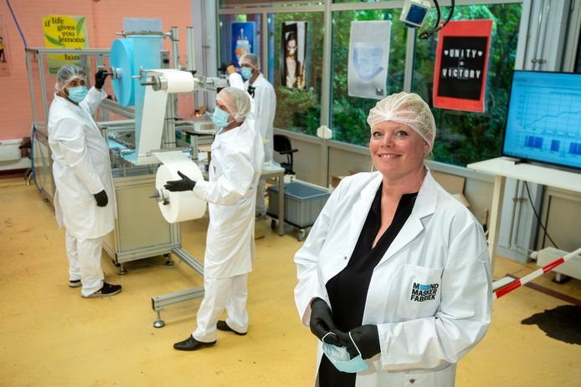
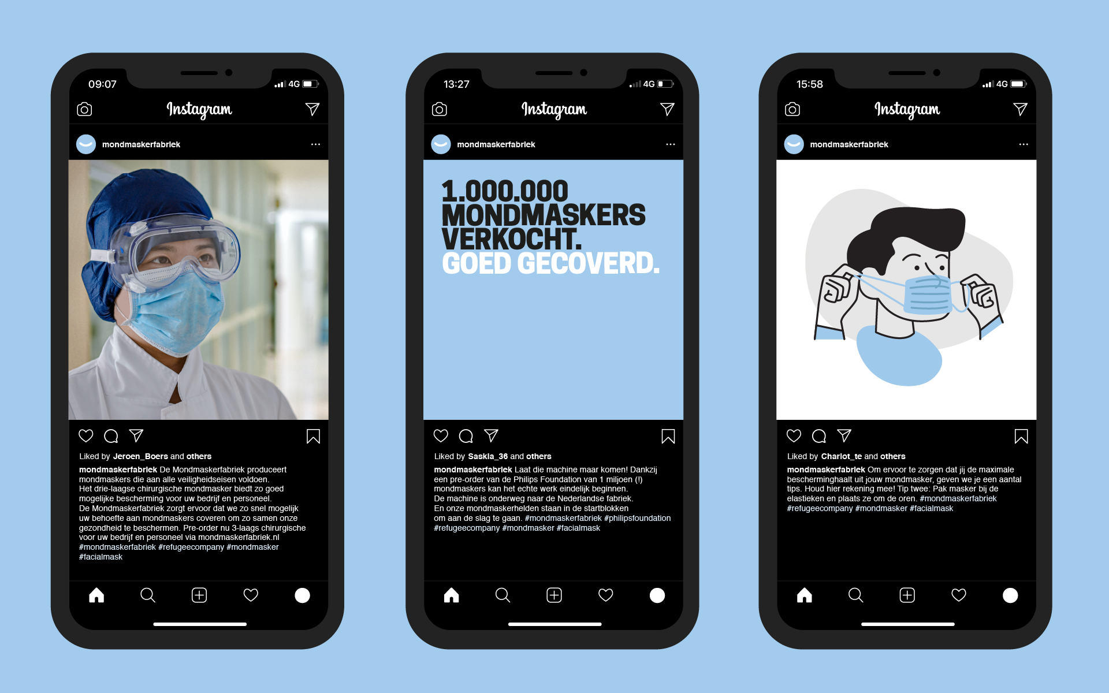
HERoS/D1.1 Emergent Organizations
Governance and policies
WP1/D1.1
VU
Social entrepreneurial actions in response to COVID19

Slide 8
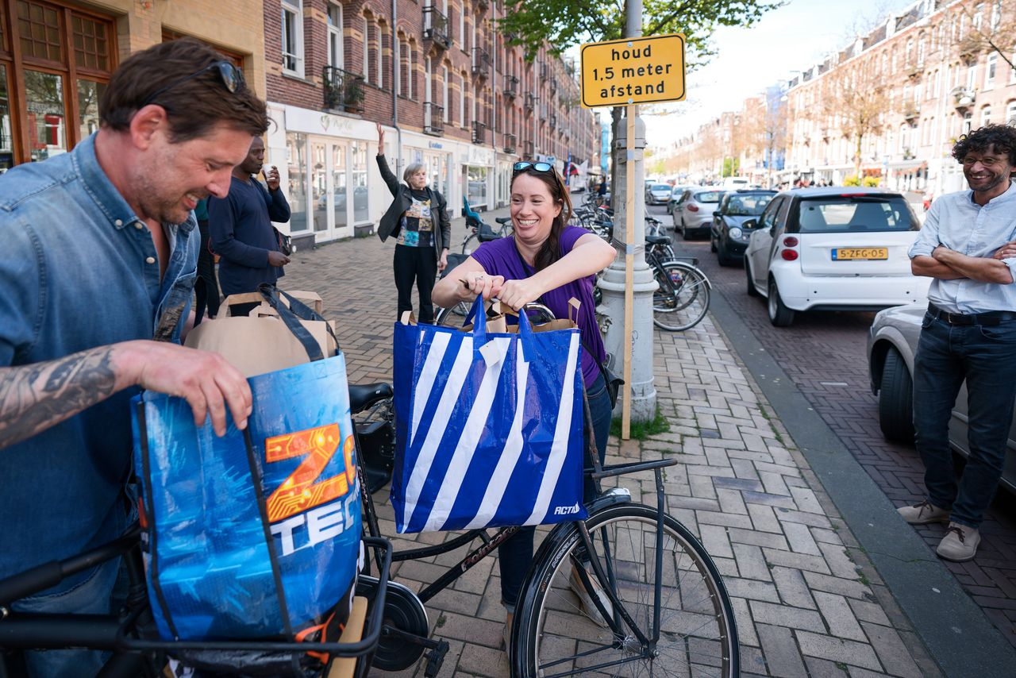
HERoS/D1.1 Resilience and Participation
Governance and policies
WP1/D1.1
VU
Provision of free meals by volunteers in Rome and Amsterdam
Vrije Universiteit Amsterdam

Slide 9
HERoS/D1.1 Crisis Governance Framework
  Main lessons learned and recommendations
  The various stakeholders involved in formal and informal decision-making need to collectively make sense and co-create a shared understanding of the crisis situation.
  Involving a broad and diverse group of interacting stakeholders helps avoid tunnel vision, assists breaking down decision-making silos, enhances collective ownership of the societal response and allows creative solutions to emerge.
  Capacity building in crisis governance means investing in people, building capabilities, nurturing networks and trustful relationships among a diverse and inclusive community of interacting and interdependent societal actors.
Governance and policies
WP1/D1.1
VU

Slide 10
D2.1 “Local response and recommendations”
Health Emergency Response in Interconnected Systems (HERoS)
Tina Comes & Mikhail Sirenko (Delft University of Technology)
Notes:
Hello everyone
My name is Mikhail
I would like to share with you highlights of results of WP2
Local response and recommendations

Slide 11
D2.1 Objectives and methods
  Objectives:
  Understand spread of COVID-19 at urban scale;
  Behaviour of citizens and their spatial contacts are the keys;
  Provide recommendations on effectiveness of policies.
Methods:
Modeling an artificial city: large scale high-resolution agent-based model (based on work of Ge et al., 2014);
Only open data used as an input to protect individual privacy.
2 case cities: The Hague, the Netherlands and Helsinki, Finland;
Delft University of Technology

Slide 12
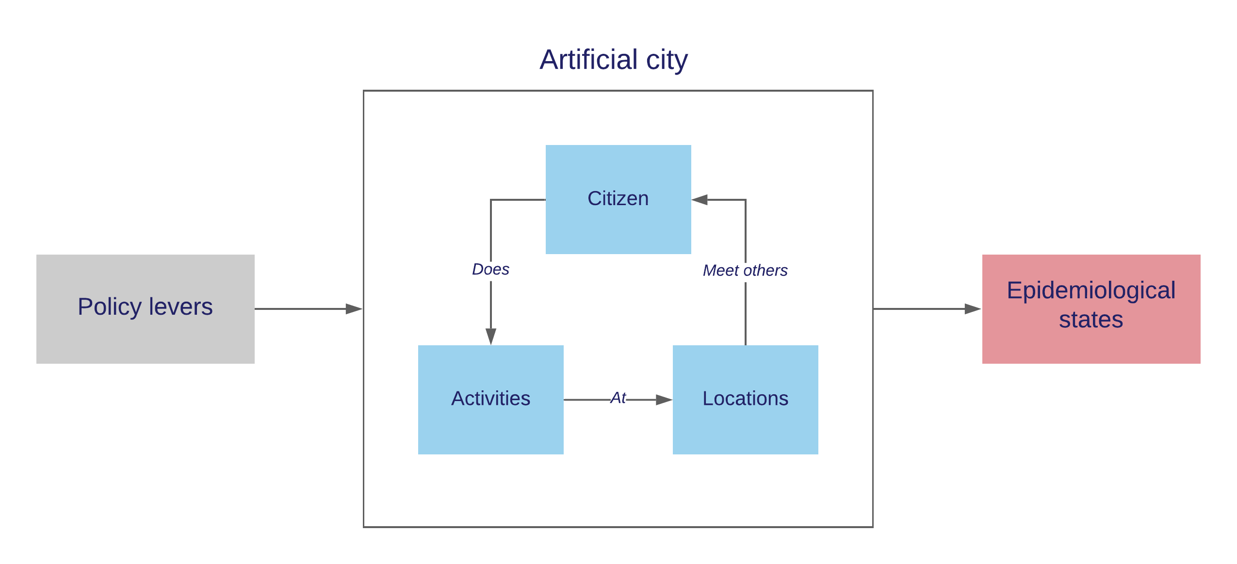
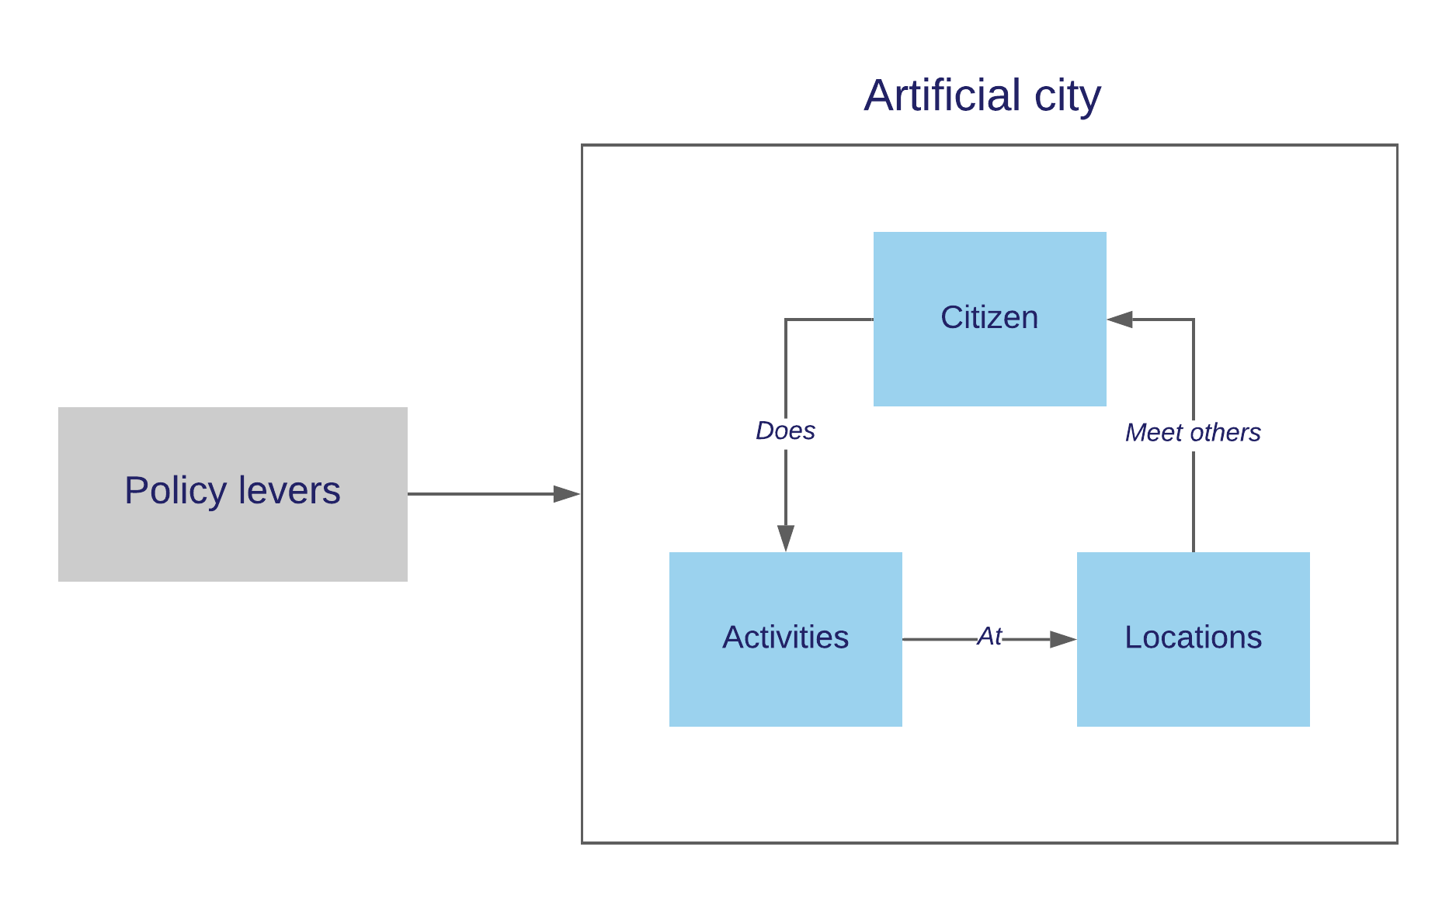
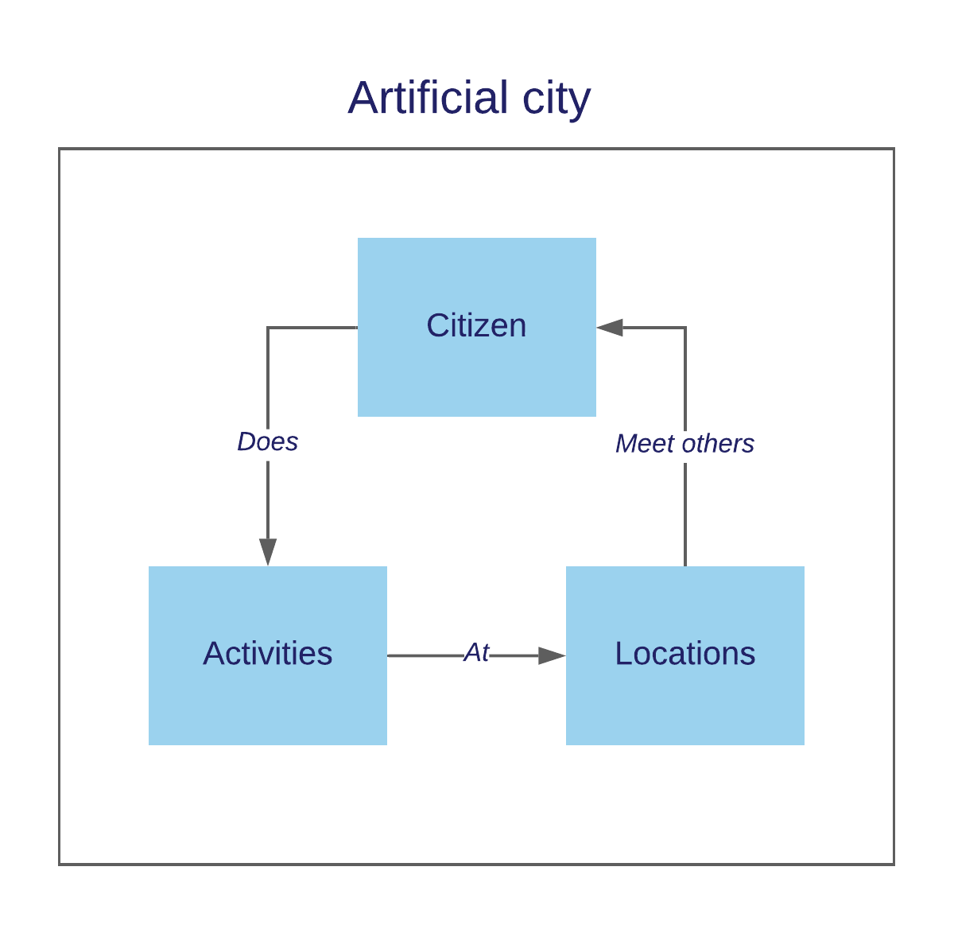
1.1 Conceptual model
Delft University of Technology

Slide 13
1.2 Simulation model
≈ 535k and 600k agents 7 age groups 1-8 family members Single, w and w/o children 5 income quintiles Occupation | 10 behavioral profiles Infants School & university students Regular & essential workers Pensioners Unemployed | ≈ 200 000 locations Home Workplace Schools and universities Shops and malls Museums, theaters, cinema
Delft University of Technology

Slide 14
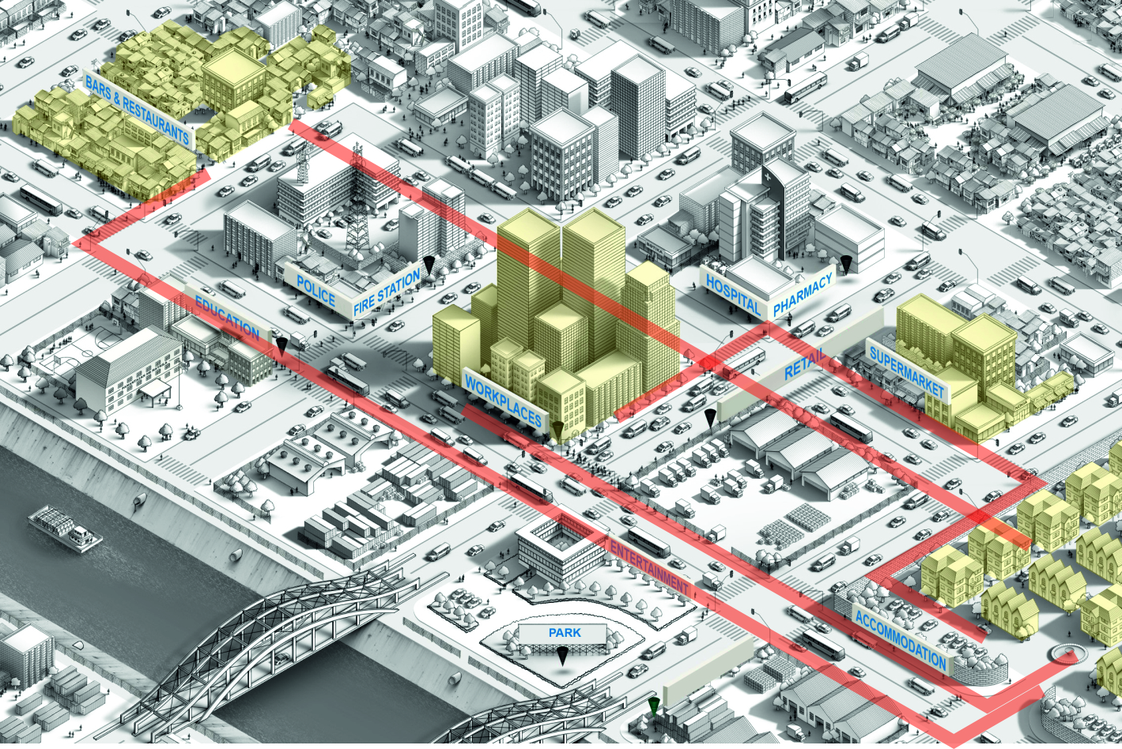

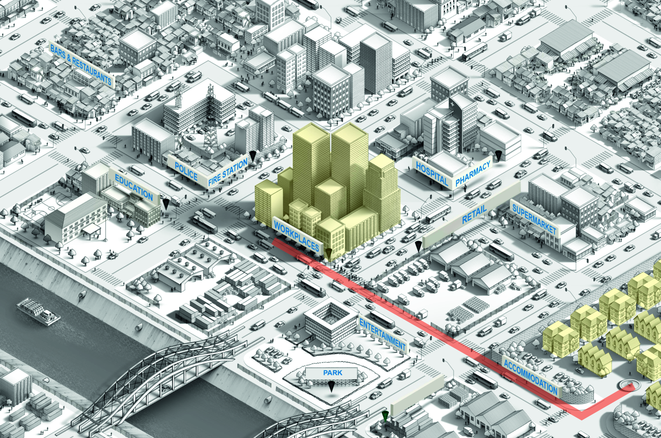
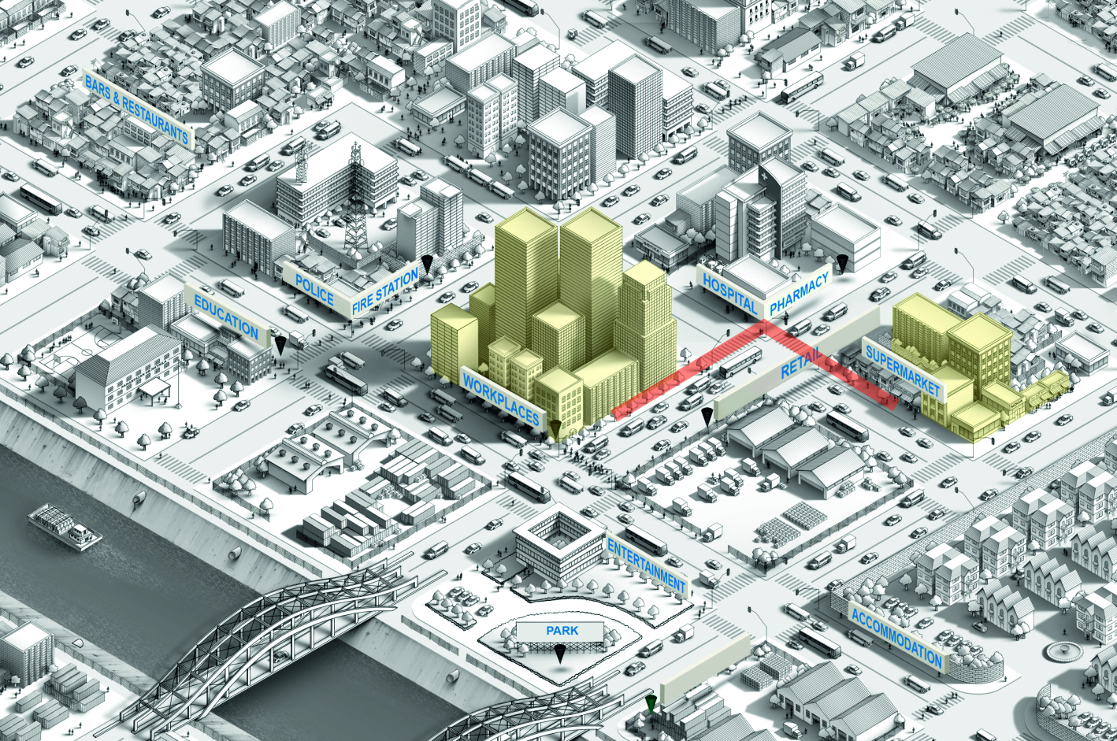
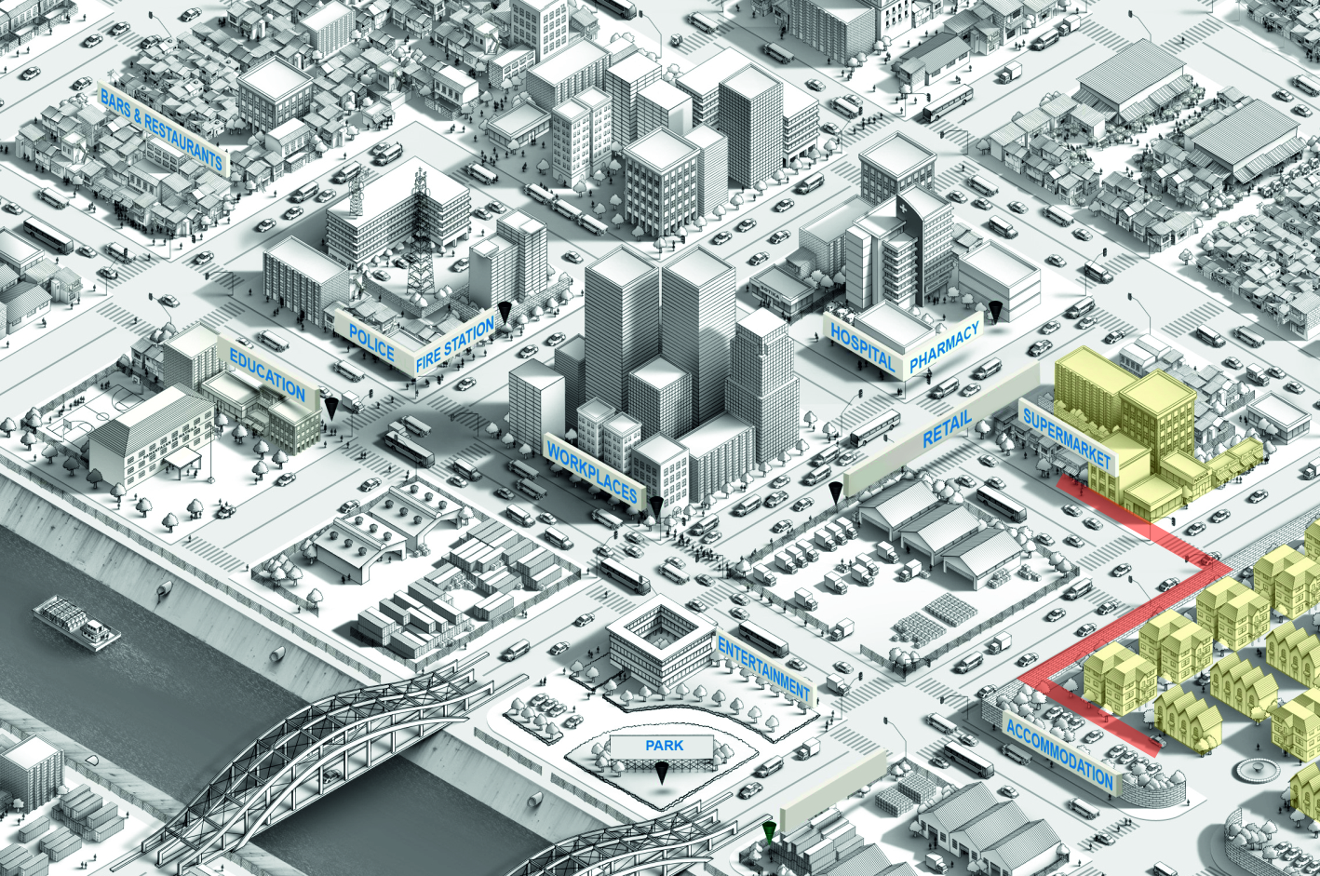
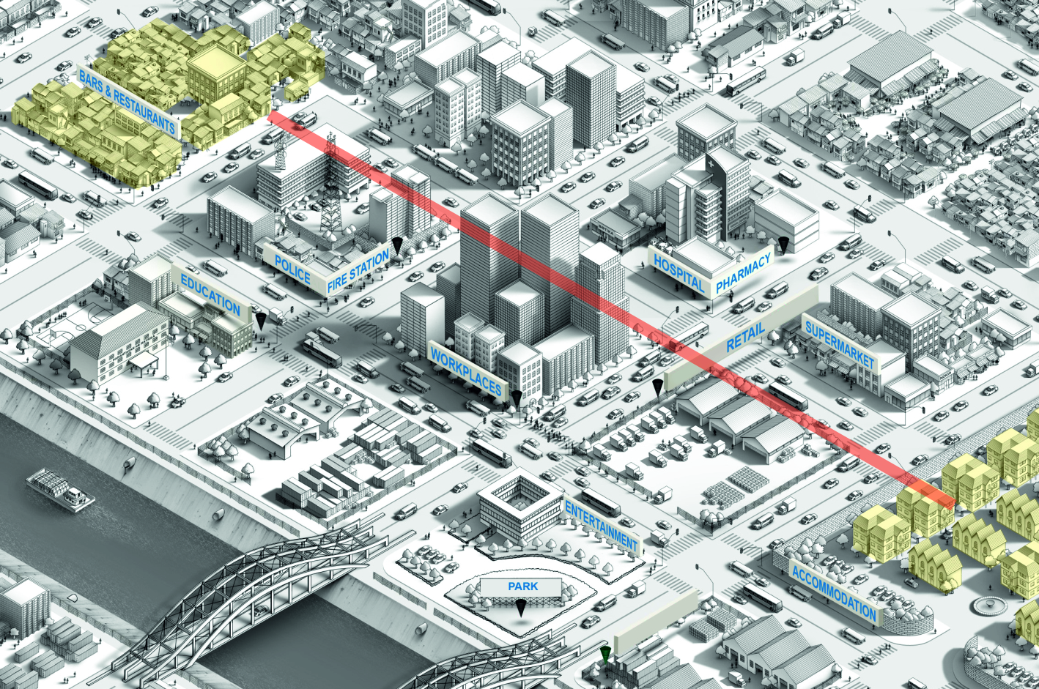
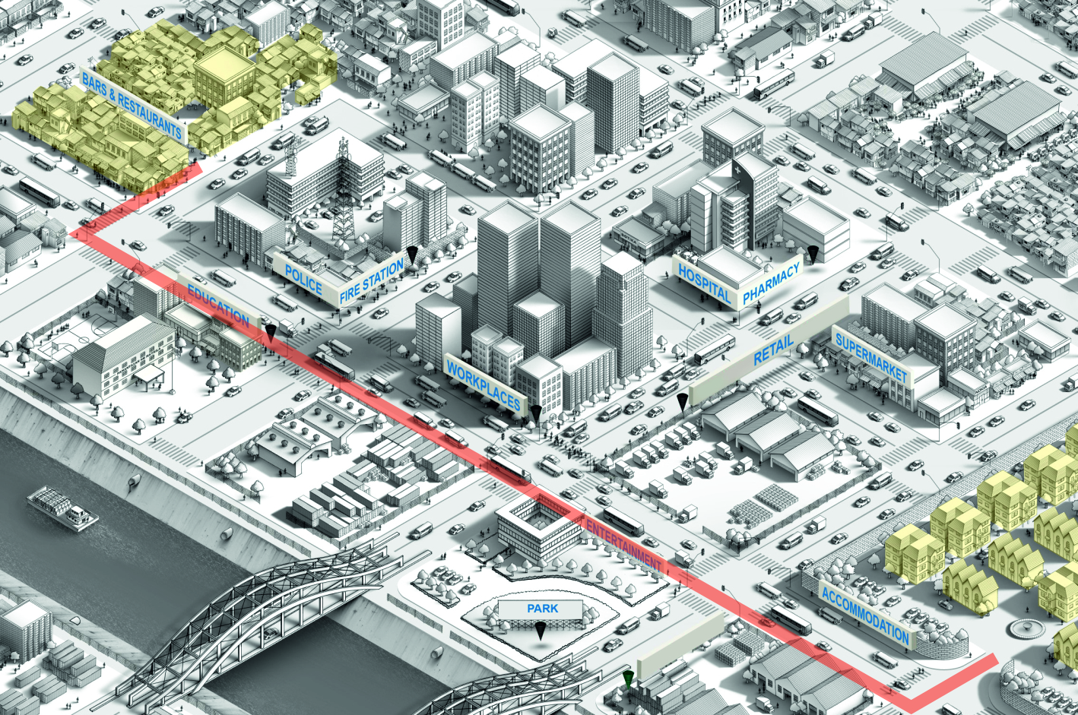
1.3 Locations
Delft University of Technology
https://nl.pinterest.com/pin/392728030007469412/
https://nl.pinterest.com/pin/392728030007469412/

Slide 15
2. Experimental setup
We test our model under 4 uncertain parameters to capture epidemiological and behavioural uncertainty:
Asymptomatic fraction;
Probability of infection;
Contagious factor;
Number of initially infected individuals.
And 3 policies:
“Do nothing”;
“Soft lockdown”: closure of educational institutions and entertainment;
“Hard lockdown”: only essential businesses are open.
Delft University of Technology

Slide 16
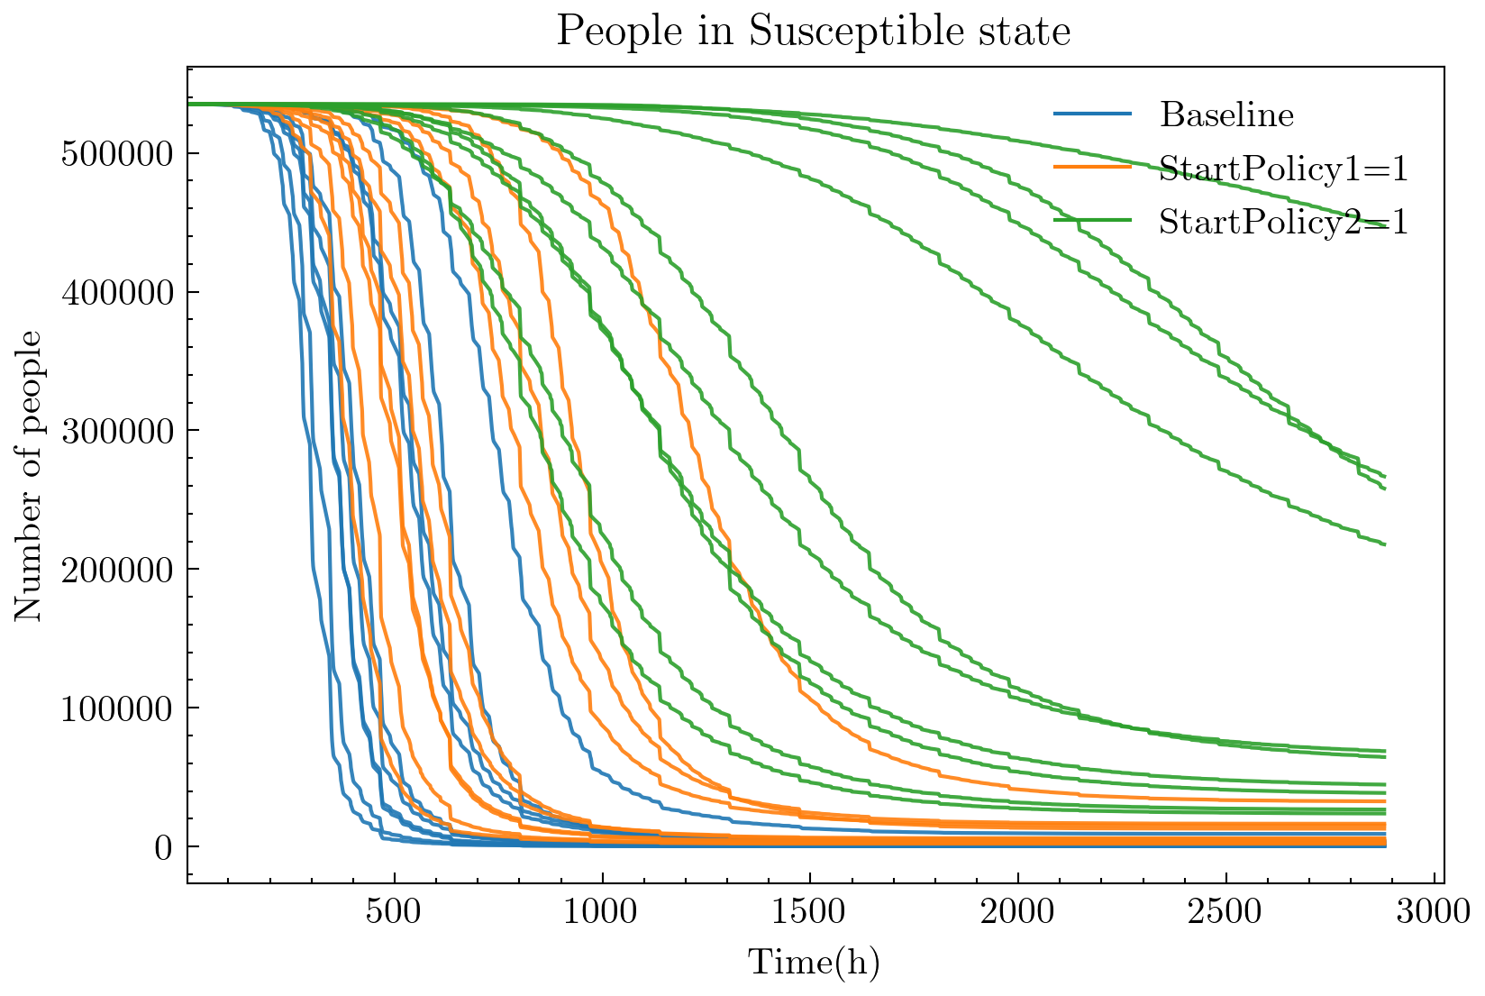
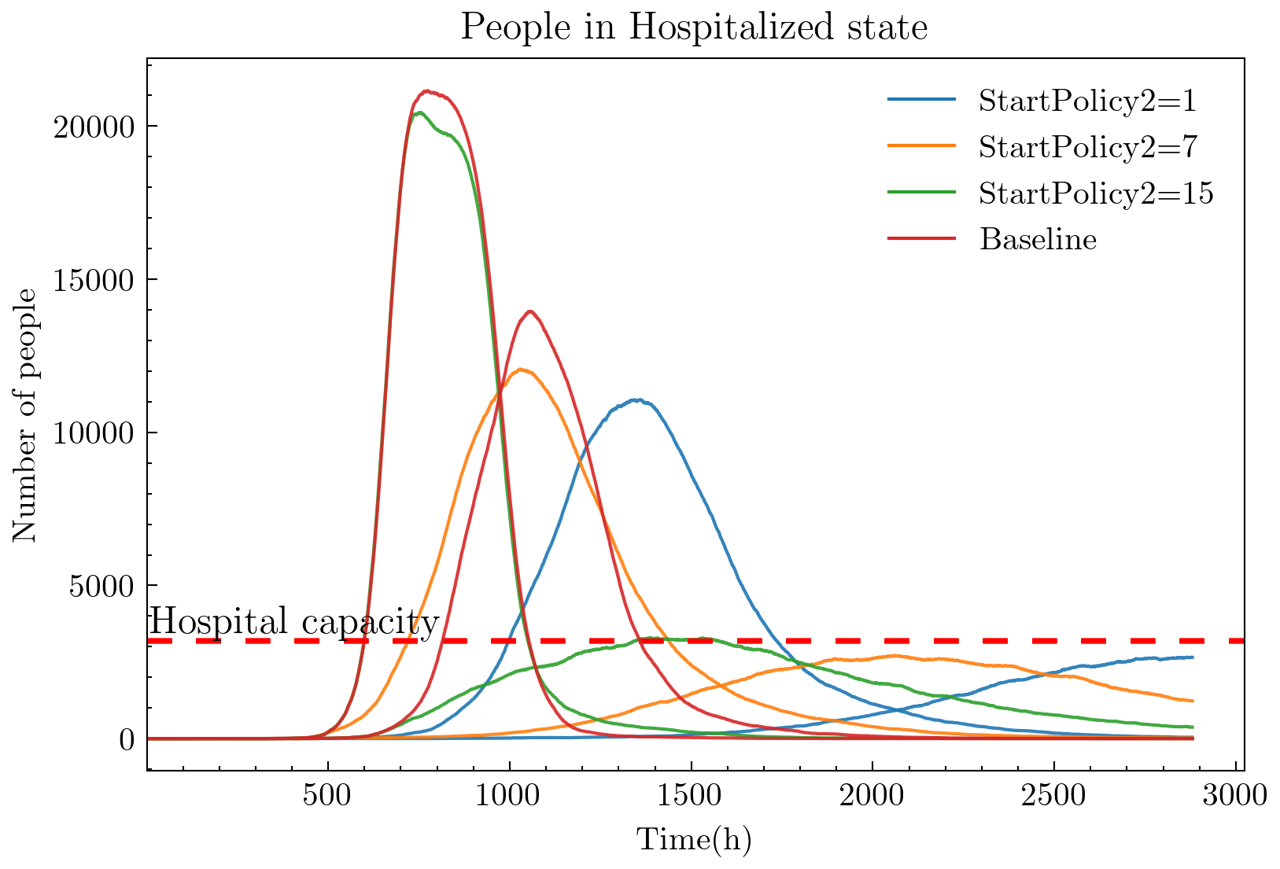
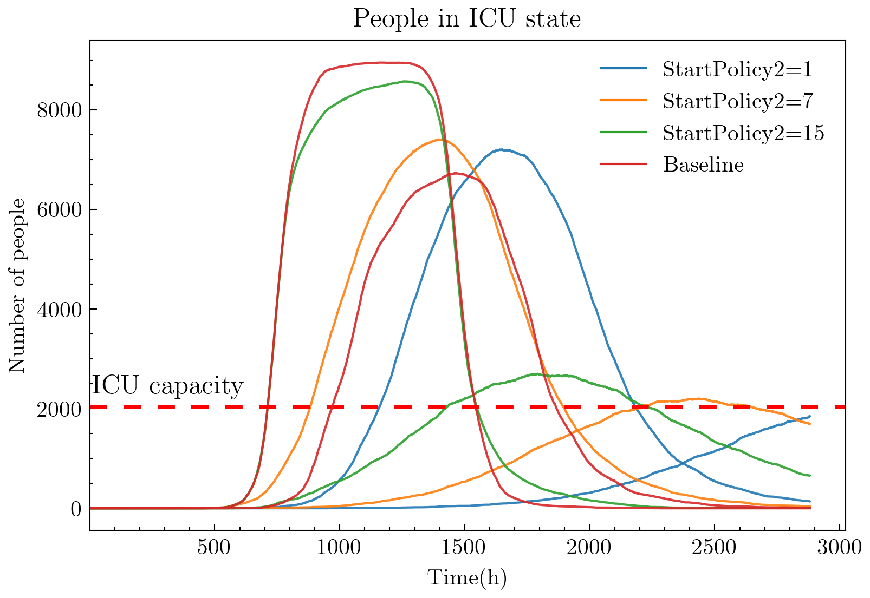
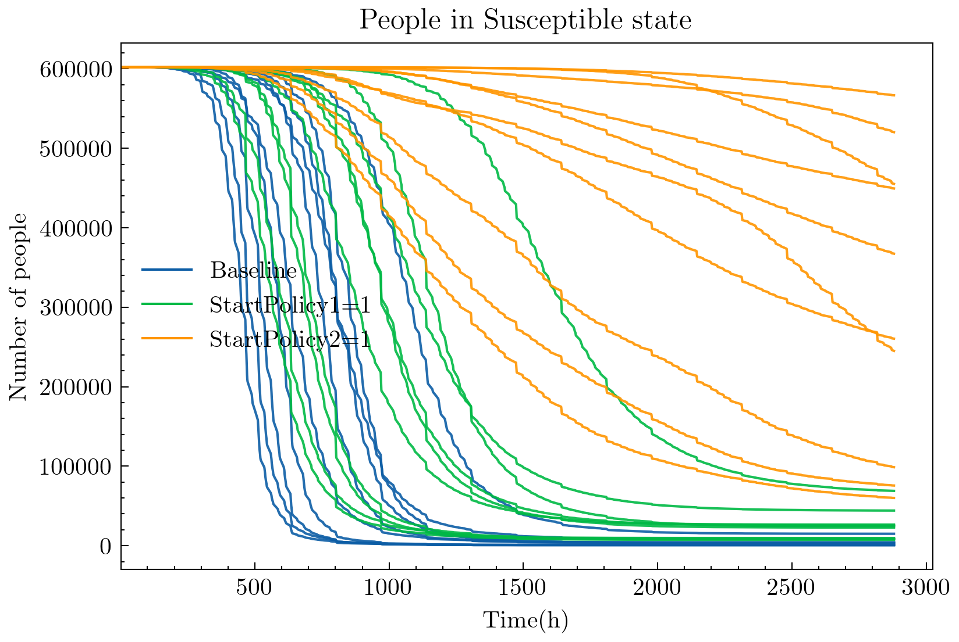
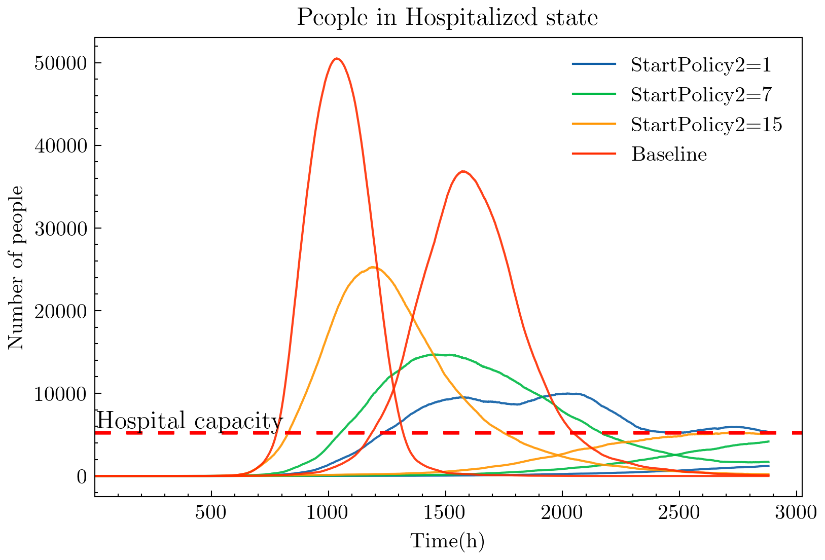
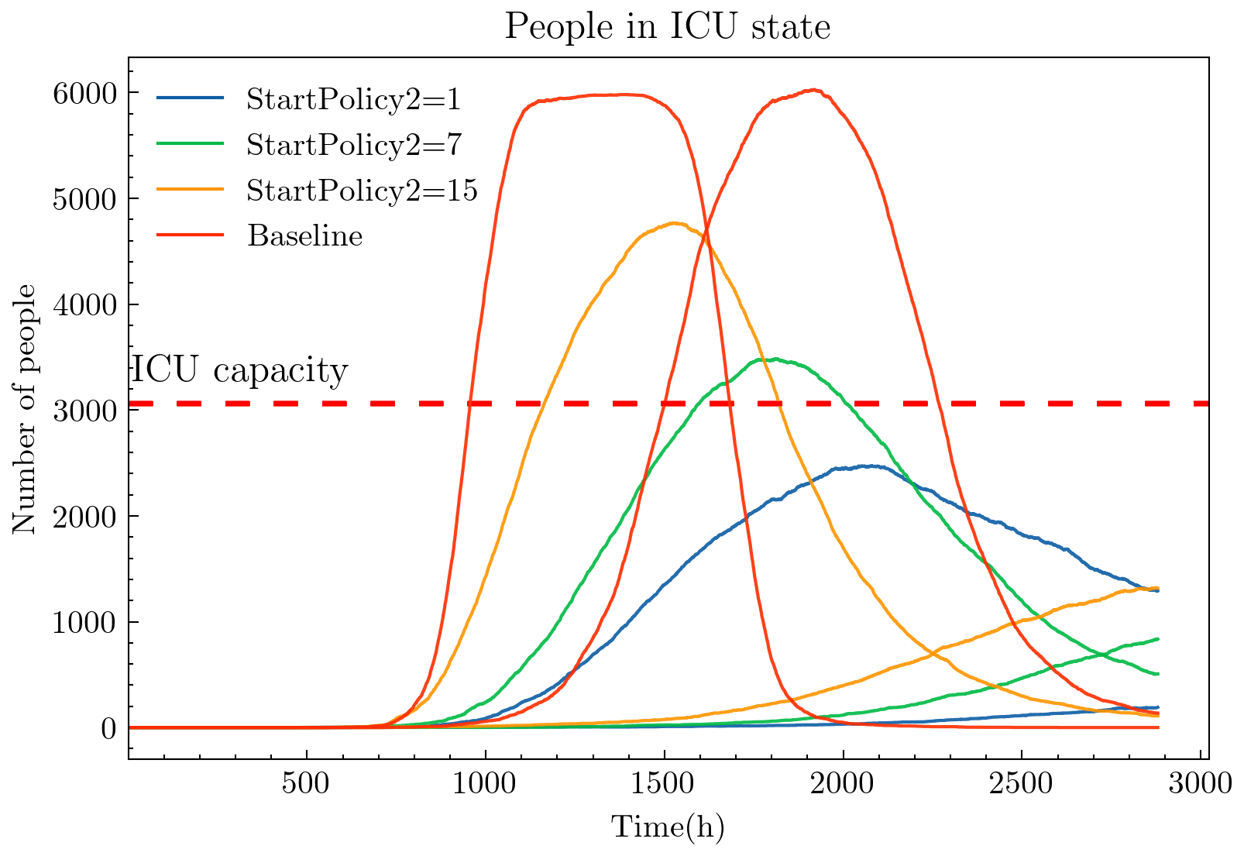
The Hague
Helsinki

Slide 17
3. Recommendations
From our simulation study we found that:
Behaviour is important. When, where and what citizen do define the spread of the disease.
Area matters. Locations with a small area (e.g. bars) but high number of visitors significantly speed up the spread of the virus.
Timing matters. The earlier the policy is implemented the better.
Soft measures may not work. Closure of educational institutions and recreation/entertainment is not as effective as full lockdown. The number of spatial contacts happening at the places that are still open is high enough to fuel the pandemic.
Prevent crowding, especially at supermarkets under full lockdown. Supermarkets can become “urban airports” and spread the virus across the city.
Delft University of Technology

Slide 18
D2.2 Public health system analysis and recommendations
Health Emergency Response in Interconnected Systems (HERoS)
Ira Haavisto (Nordic Healthcare Group)

Slide 19
HERoS task 2.2 focuses on healthcare systems and services required by COVID-19 patients, spring 2020
Health care system analysis
Primary focus areas
The task focuses on healthcare systems in new kind of operating environment caused by the novel coronavirus
Focus is on services to COVID-19 patients – although other HC services were affected as well
Timeframe of this research covers spring 2020 and thus the “first wave” of COVID-19 pandemic in most of the Europe
COVID-19 data (spread, mortality etc.) has been vital in the task
The HERoS project and the task 2.2 aims at fact-based policy recommendations
Statistical model for COVID-19 spread
1
Hospital intensive care capacity utilization
2
Behaviour of the healthcare professionals
3
Existing
preparedness assessments
4
Diagnostics strategies
5
Nordic Healthcare group (www.nhg.fi)

Slide 20
Methodology – Linear mixed effect model
Statistical model for COVID-19 spread
Data
What is the explanation behind the differences in the spread of the COVID-19 epidemic between countries? Were the chosen non-pharmaceutical interventions effective, and which interventions had the greatest impact in preventing the death toll from rising?
COVID-19 mortality data
    Provided by Johns Hopkins University
  Country features data
    Comprehensive selection of demographic, cultural and healthcare system specific data on country level
    Aim to include the demographic features being present in the public discussion and the academia as potential reasons for COVID-19 advancement as well as features presented as risk factors in previous pandemics
  Intervention data
    Data on both individual interventions and the readily provided stringency index
    Data assembled by The Blavatnik School of Government (OXFORD COVID-19 Government Response Tracker)
Model: Linear mixed effect model, allowing each country its own intercept. Robust to repeated measures.
Dependent variable: Daily mortality change, DMC. (Percentage-wise daily change in 7-day moving average of cumulative daily deaths per 1M population, reflecting the pace the death toll is either rising or decreasing)
Model variables: 1) Number of days since first death, day, to account for the overall trend of decreasing mortality 2) Set of country features selected from regressions including the feature, days since first death and stringency index controlling for the interventions, and had to have statistically significant relation to DMC 3) Interventions with a 18-day lead, measured either by stringency index, or data on ongoing interventions on category level or independently
Model 1 – Country features and stringency index
Model 2 – Intervention categories
Model 3 – Independent interventions
Diabetes prevalence within the population and Geert Hofstede’s masculinity, i.e. the extent to which the use of force is endorsed socially, proved being statistically significantly correlated with higher DMC
Cancelling public events seems to have the largest impact, followed by controlling international travel, closing workplaces and closing schools respectively. The other intervention categories do not show effects on DMC
Requiring all school levels to close, either recommending or requiring public events to be cancelled, recommending closing internal movement or intervening international travel in any fashion all had an effect to reduce mortality
Findings
Nordic Healthcare group (www.nhg.fi)

Slide 21
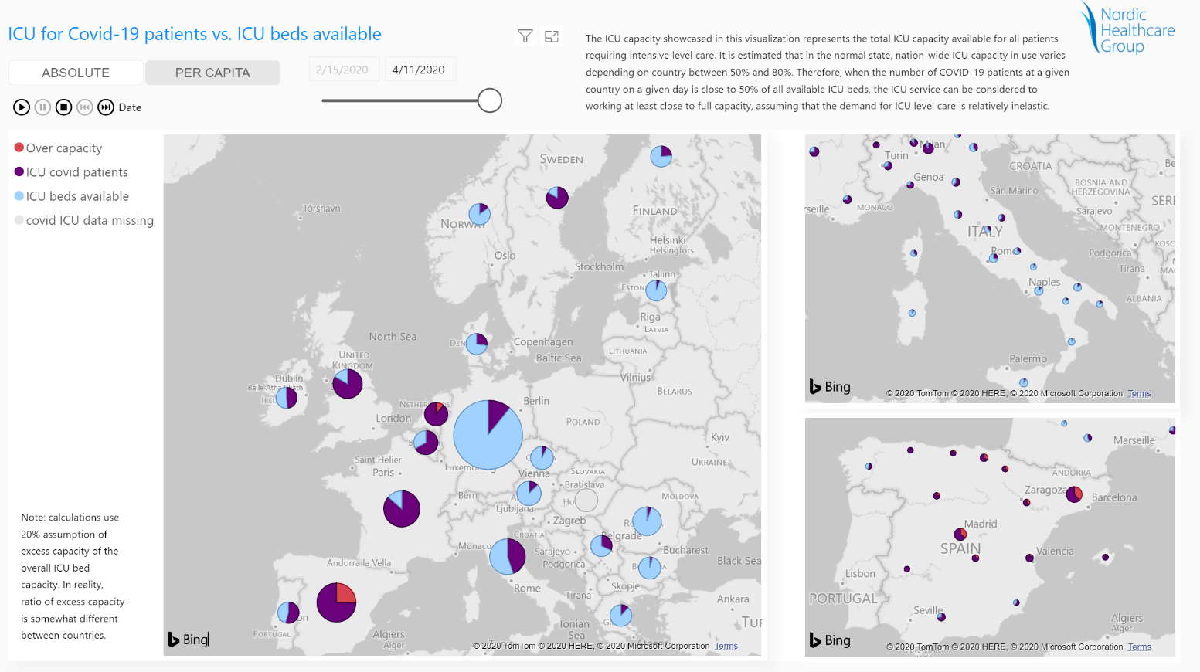
Interactive tool to view hospital intensive care unit (ICU) utilization was developed
The link to the tool will be publicly available on the HERoS webpage in November
Nordic Healthcare group (www.nhg.fi)

Slide 22
Healthcare professionals faced uncommon working load and uncertainty
Findings from interviewes with Finnish, Italian and Swedish healthcare professionals who worked at the ICU during the first wave:
Preparedness of the hospitals
Stress of the healthcare professionals
Challenges in management and leadership
Sufficiency of resources
The healthcare professionals in general were initially surprised and overwhelmed
Crisis management plans existed but were not detailed enough
Preparation measures and redesign took place
Healthcare professionals worked overtime
The load and stress of the professionals was not spread out equally
The group spirit was temporarily higher than normal in the beginning of the pandemic
Professionals raised concerns for a prolonged epidemic situation
There was miscommunication or lack of communication at the start of the first wave
ICU professionals highlighted the need for clear communication during crisis
ICU professionals called for support and concrete actions from the management to ease stress
The temporary extra personnel was helpful in managing the growing number of patients, but at the same time brought up challenges
There was fear of shortage in all three countries and actual shortage in Italy of PPEs
The availability of other resources and equipment varied: shortages of drugs in Sweden and initial shortage of ventilators in Italy
Nordic Healthcare group (www.nhg.fi)

Slide 23
Policy recommendations from the healthcare system analysis
Interventions designed to prevent the spread of the virus had an effect on the mortality change
Social distancing interventions played a role, most of the country features did not seem to have an effect on the mortality change
Good preparedness for pandemics did not always protect from the impact of COVID-19
EU could devise a common framework for interventions
More cooperation across regional and national borders could have helped the areas worst affected by the pandemic
Systems were slow to ramp up capacity required to test and treat COVID-19 patients
More cooperation across regional and national borders would have helped the areas worst affected by the pandemic
Improving the access, reliability, precision and timeliness of the pandemic related data
Improving the access, reliability, precision and timeliness of the pandemic related data would help decision-makers
Open access to relevant information from different primary sources in different countries on a single portal or platform would help timely decision making
Paying attention to the stress and workload of the professionals
The wellbeing of healthcare professionals should receive more attention in the next phases of the epidemic
To support hospital management in communicating clearly and timely, sufficient information, policymakers could consider looking into the possibility of providing more or more specific guidelines and recommendations to pandemic management on a hospital level
Nordic Healthcare group (www.nhg.fi)

Slide 24
D3.1 Gap analysis and recommendations for securing medical supplies for the COVID-19 response
Health Emergency Response in Interconnected Systems (HERoS)
Gyöngyi Kovács (Hanken School of Economics)

Slide 25
HERoS/D3.1 Objectives and methods
Medical Supply Chains
WP3/D3.1
Hanken
  Objective: Identify gaps in medical supply chains caused by COVID-19 and make recommendations.
Methods: exploratory-qualitative, based on 38 interviews in 8 countries with experts from HERoS end users (Italian Red Cross, Project HOPE, Polish Center for International Aid) and relevant stakeholders
Analysis framework of operational, financial, and strategic supply chain disruptions
Hanken School of Economics

Slide 26
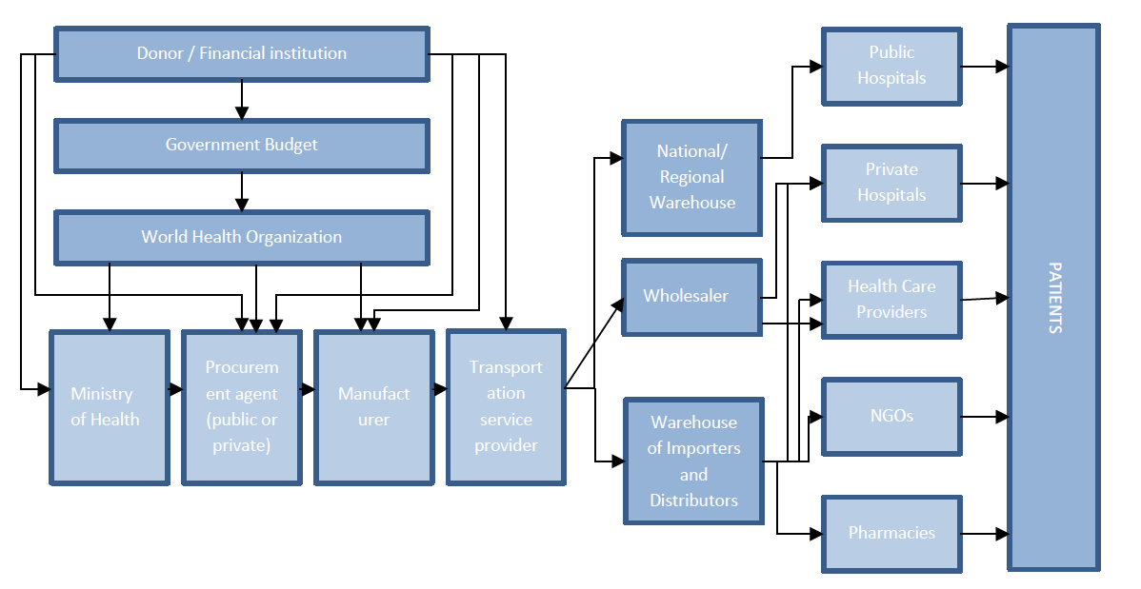
HERoS/D3.1 Medical supply chains
Medical Supply Chains
WP3/D3.1
Hanken
Hanken School of Economics

Slide 27
What we expected (the framework)
Medical Supply Chains
WP3/D3.1
Hanken
  Operational gaps:
  Behavioural: bullwhipping, price speculations, fraud
  Capacity-related: workforce, production capacity constraints, raw material shortages
  Legislative: regulatory uncertainty, certifications and standards, export bans, customs
  Financial gaps:
  Economic impacts of sales, expenses and donations
  Economic impact on and through the workforce
  Strategic gaps:
  Supply chain design-related: sourcing strategies, facility location
  Risk management
Hanken School of Economics

Slide 28
What we found (surprising highlights)
Medical Supply Chains
WP3/D3.1
Hanken
  Bullwhipping for PPE, but also for e.g. paracetamol
  Sudden large capacity constraints in transportation, with enormous price hikes <-> stop of air (passenger) traffic
  Lack of due diligence leading to quality issues, non-deliveries or long lead times
  Single sourcing but also “China+1” strategies causing disruptions
  Lack of understanding interdependencies -> removing one constraint leads to the highlight of another (e.g. test swabs, reagents)
  Lack of global certifications and quality standards
Hanken School of Economics

Slide 29
Key recommendations for medical supply chains
Preparedness
Pre-positioning
Regulation
Price regulations / rationing of critical items
Innovation
Training
Global product and quality standards
Assurance of cargo movements even in lockdown
Multiple sourcing strategies with geographical diversification
Non-earmarked funding for disaster incl. pandemic response
Collaboration
Joint procurement also across countries
Public-private partnerships and cross-sectoral collaboration
Framework agreements incl. supplier vetting
Pandemic risk plans
Incentives for production changeover (also for transportation capacity)
Structural flexibility in production, transportation, sourcing
Kitting of interdependent items
Non-person-dependent transportation (e.g. UAVs)
End-to-end supply chain visibility
Hanken School of Economics

Slide 30
D4.1 Assessment of the online spread of coronavirus misinformation
Health Emergency Response in Interconnected Systems (HERoS)
Harith Alani (The Open University)

Slide 31
HERoS/D4.1 COVID-19 misinformation tracking
Objective: measure the co-spread of misinformation and their corresponding fact-checks, to better understand their patterns and correlations.
Methods: compare the diffusion of misinformation and fact-checking URLs about COVID-19 on Twitter
Misinformation is false or inaccurate information. Examples of misinformation include false rumours or more deliberate disinformation such as malicious content such as hoaxes and computational propaganda.
Fact-checking is the process of verifying information in non-fictional text in order to determine its veracity and correctness.
The Open University, UK

Slide 32
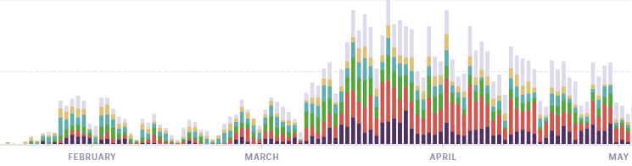
Misinformation and Fact-Checking spread during Covid-19
During the Covid-19 pandemic the amount of misinformation shared on social media has risen significantly with some tragic results.
Fact-checking organisations have been correcting misinforming content. However, the effectiveness of corrective information remains largely unknown.
“Rumours about coronavirus – that it can be prevented by drinking alcohol; that it is killed by cold or heat – pose serious risk.”
Did fact-checking during the Covid-19 pandemic have a positive impact in reducing misinformation spread?
Amount of new fact-checks per day. (Source: Poynter)
Peak: 143 per day.
The United Nations
17 Apr 2020
32
Notes:
32

Slide 33
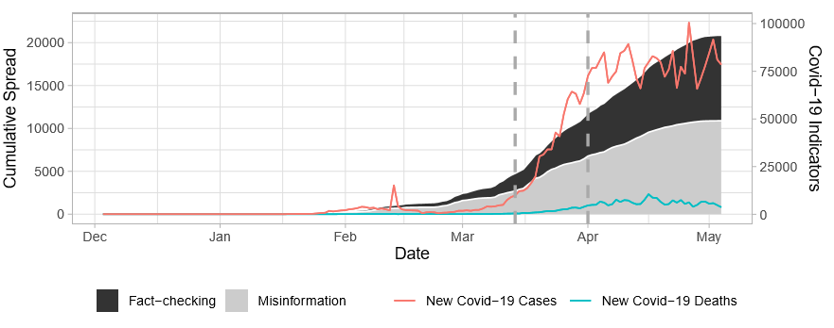



Data collection
We collect tweets mentioning misinforming and fact-checking URLs.
Fact-checks and misinforming URLs are obtained from websites belonging to the International Fact-Checking Network (IFCN).
ClaimReview is a tagging system that fact-checkers use to identify their articles (i.e., claims, ratings fact-checked content and fact-checking URL).
Data collected until 4th May 2020
2,830 Misinforming URLs
734 Fact-checking URLs
21,394 Tweets
Stacked cumulative spread of misinforming and corrective information.
twitter
misinfo.me

Slide 34
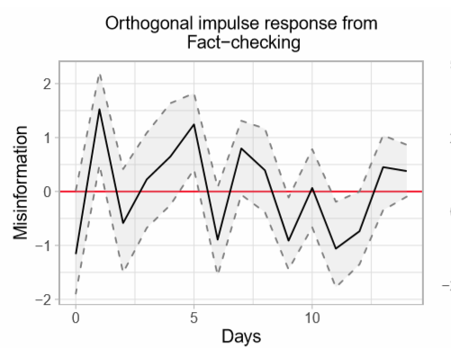
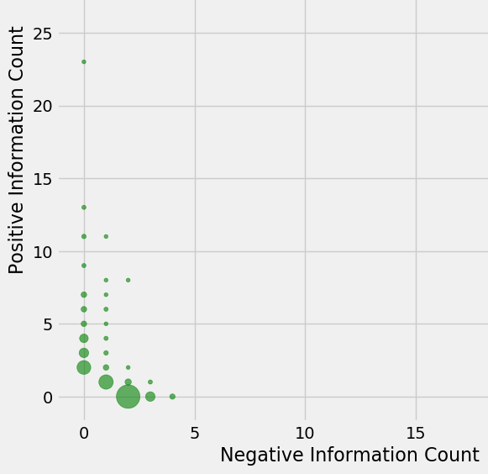
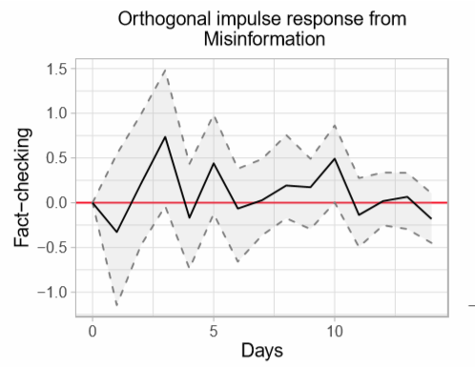
Causality and Impulse Analysis
Our analysis confirms that misinformation spread is inﬂuenced by fact-checking.
  Misinformation spread can be predicted from fact-checking spread, but not the other way round
  Fact-checking impulse generates a slow downward trend in misinformation spread.
  Misinformation impulse generates a delayed fact-checking spread response.
Downward misinformation spread trend
Fact-checking delayed spread response
Notes:
34

Slide 35
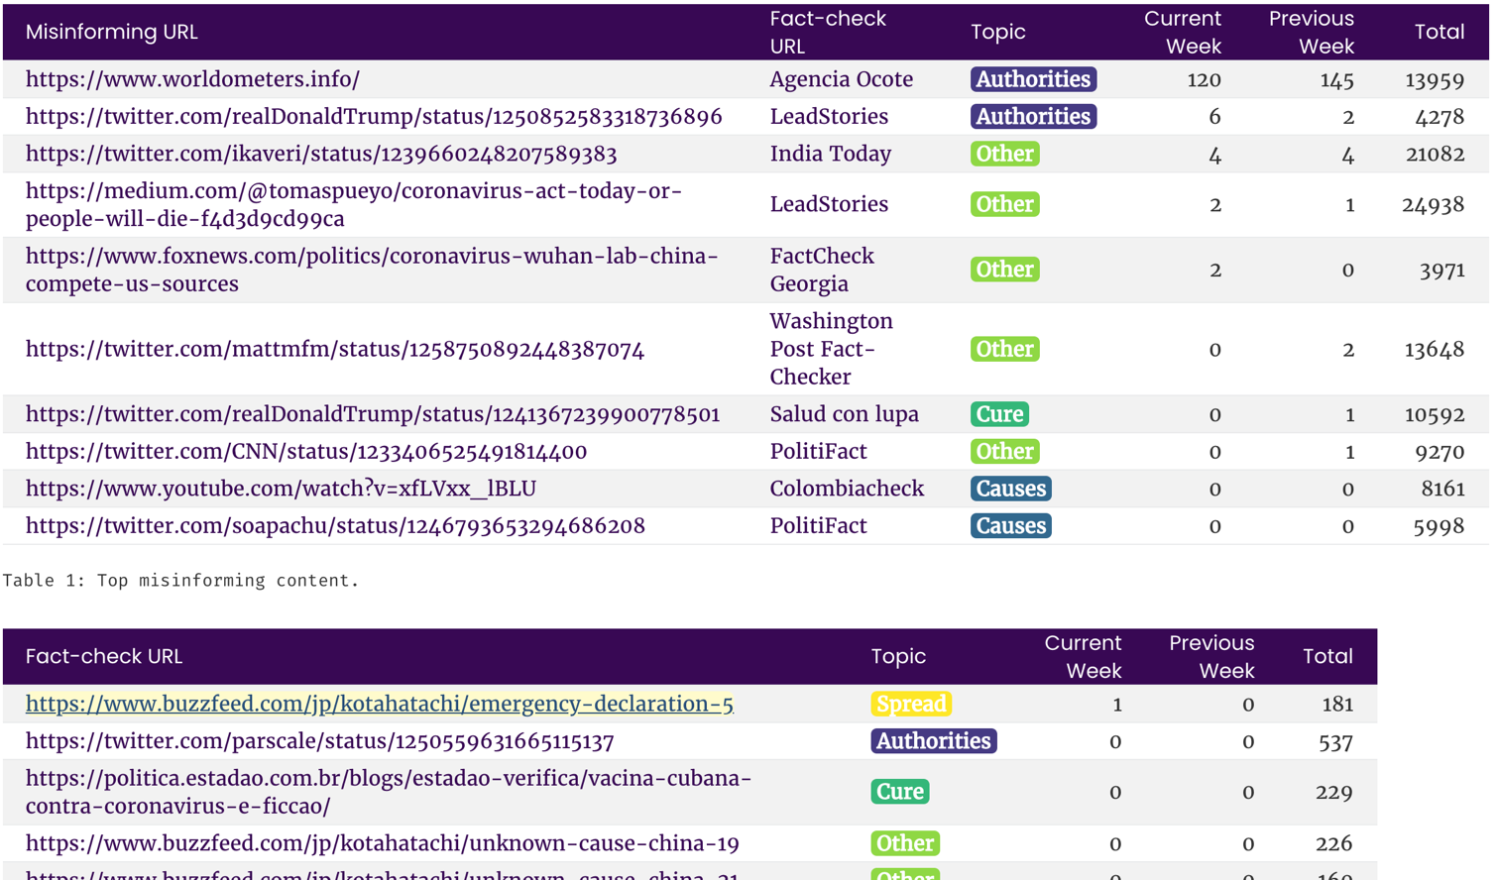

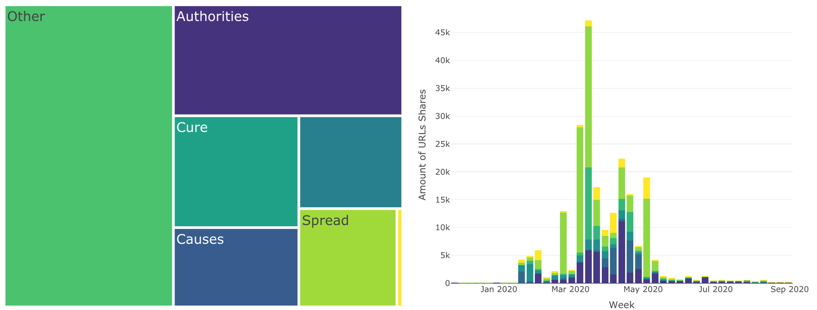
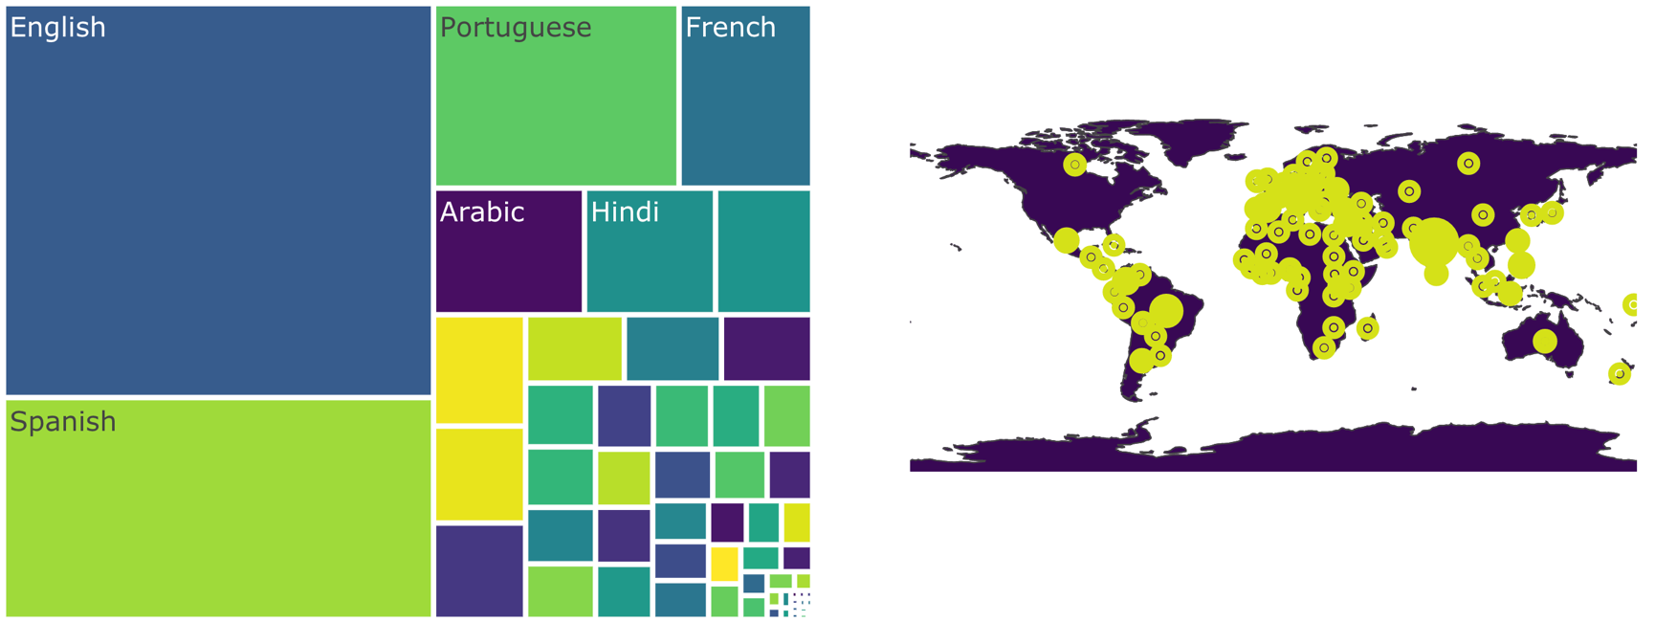

Slide 36
Joint results (highlights)
HERoS Rapid Response Phase
  Effectiveness of policies that reduce social interaction (D1.1, D2.1, D2.2)
  Two-edged sword of stopping air transportation: reduced spread (D2.2) but large gaps in medical supply chains (D3.1)
  Local capacity constraints of ICU doctors and nurses, not just materials (D2.2, D3.1)
HERoS consortium

Slide 37
Questions

